Slide 1
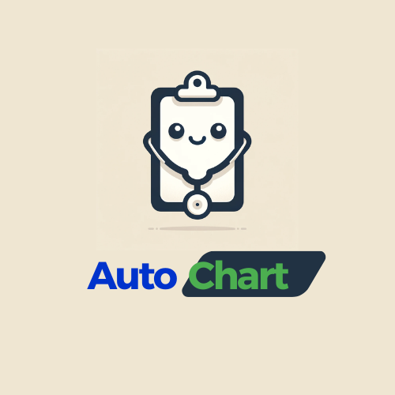
Transforming doctor-patient conversations into ready-to-use medical charts.
Jayden Yeo, Founder
Notes:
Good afternoon ladies and gentlemen, my name is Jayden and I am here to present AutoChart.

Slide 2
THE PROBLEM
High burnout rates in physicians
70% - 80% of Internal Medicine residents in Singapore
54% of physicians in the US
Associated with documentation activities and administrative burdens
Healthcare workers spend up to 50% of their time on documentation
Reduced patient care
Notes:
Over the past few years, more and more physicians are experiencing burnout as a result of the covid-19 pandemic.
Studies have shown that 70-80% of internal medicine residents in Singapore and 54% of all physicians in the US experience severe burnout
This burnout epidemic is often associated with documentation activities and administrative burden, with healthcare workers spending up to half their time on documentation
This affects patient care as physicians report that they feel rushed due to the need to complete documentation before they end their day

Slide 3
PRODUCT
AutoChart aims to alleviate these pressures by streamlining medical documentation processes.
AutoChart transforms doctor-patient conversations into transcribed, well-organized, medically precise charts.
Notes:
Our product AutoChart seeks to reduce pressure by streamlining medical documentation processes.
In particular, it transforms doctor-patient conversations into transcribed, well-organized and medically precise charts.

Slide 4
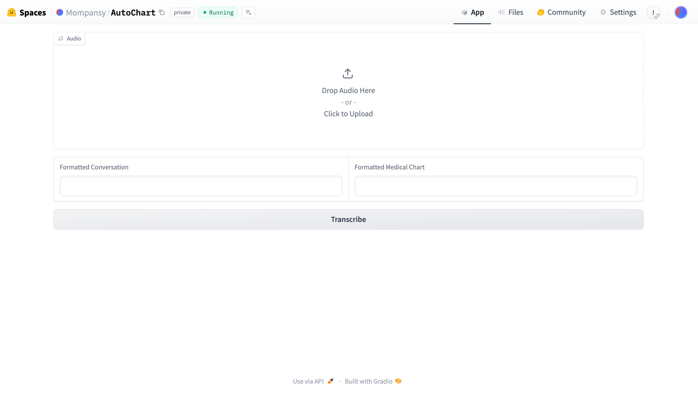
Notes:
Here is a screenshot of our product hosted on huggingface spaces. The recorded conversation can be dropped in the upload box. Once that's done, we hit transcribe.

Slide 5
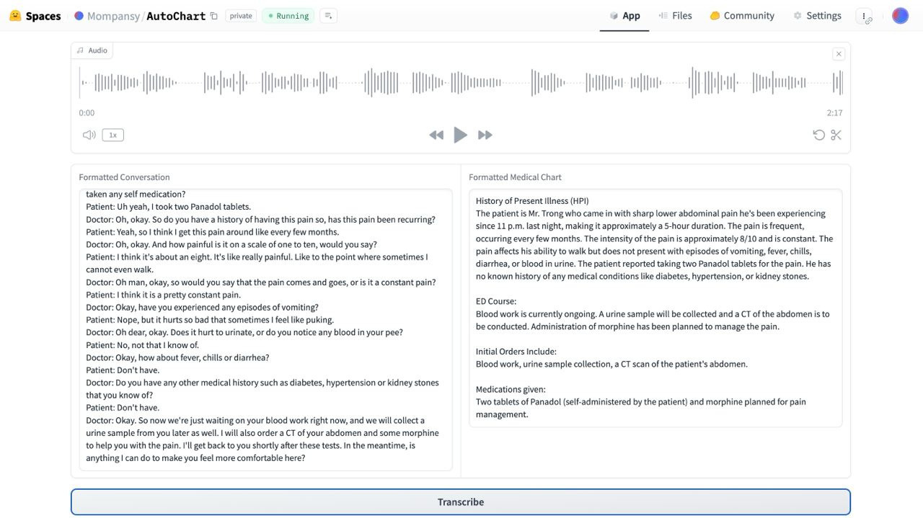
Notes:
After a few minutes of processing, it shows the transcribed conversation on the left, and the formatted medical chart on the right

Slide 6
DEVELOPMENT PROCESS
Fine-tune Whisper Small
Reformat using GPT-4
For Singaporean english using publicly available Singapore ASR dataset
Transcribe recorded doctor-patient conversation using fine-tuned model
Format the transcription into medical chart
Notes:
The development process of AutoChart involves first fine tuning the whisper small model provided by openai.
I used the publicly available Singapore Automatic Speech Recognition dataset to tune it to Singaporean english accent.
This process involves taking raw audio data and extracting the amplitude array and applying various transformations such as the log-mel spectrogram to the array, and tokenizing the paired sentence string.
After training the model and uploading it to huggingface model registry, I use it to transcribe the recorded conversation and then format it into a medical chart using gpt-4

Slide 7
SIZE OF MARKET
TAM
29.06B
The global electronic health records market size was estimated at USD 29.06 billion in 2023 and it is anticipated to grow at a compound annual growth rate (CAGR) of 4.1% from 2024 to 2030.
SAM
660M
To date, Singapore’s expenditure on EHR systems is 660 Million in 2023
SOM
Target 30% of Singapore’s EHR market
198M
Notes:
To get an estimate of the potential market for my product, I analysed the market for electronic health records or (EHR).
The total available market is estimated at 29 Billion USD in 2023, and estimated to have a compound annual growth rate at 4.1% over 6 years
The serviceable available market is the Singapore market for EHR, where we spent 660 Million SGD in 2023
For the serviceable obtainable market, I aim to capture 30% of the market, which amounts to 198 Million SGD.

Slide 8
WHAT’S NEXT
Collaborate with Medical Professionals: To refine the document's precision.
Explore Integration Opportunities: In hospitals and clinical settings.
Pursue Regulatory Approvals: Such as FDA/ISO13485 certifications, to facilitate medical industry adoption.
Notes:
The next steps for AutoChart would be to collaborate with medical professionals to improve the use case and refine the charting output
We would also need to explore integration opportunities in hospitals and private clinics with their electronic health records to optimise work flow
Last but not least, we would also need to pursue regulatory approvals such as ISO13485 in Singapore, or FDA if there is a opportunity to expand into the US market

Slide 9
REFERENCES
https://www.ama-assn.org/practice-management/physician-health/measuring-and-addressing-physician-burnout
https://www.sma.org.sg/UploadedImg/1635214699_2018MayInsight.pdf
https://www.ncbi.nlm.nih.gov/pmc/articles/PMC7083584/
https://www.grandviewresearch.com/industry-analysis/electronic-health-records-ehr-market
https://www.insights10.com/report/apac-electronic-health-records-market-analysis/
https://www.moh.gov.sg/news-highlights/details/expenditure-on-and-utilisation-of-national-electronic-health-record-system

Slide 10
QNA

